Slide 1
Probabilistic Skyline Operator over sliding Windows
Wan Qian
HKUST DB Group

Slide 2
Introduction

Slide 3

Skyline
Find a good hotel cheap and near the beach
900 m
600 kr
700 m
600 kr
80 m
500 kr
60 m
1200 kr
20m
1100 kr
20m
400 kr

Slide 4
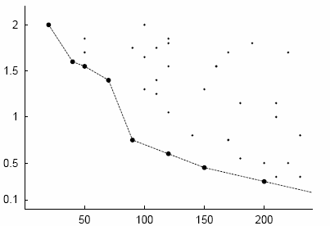
Skyline
Distance to beach (km)
Price (€)

Slide 5
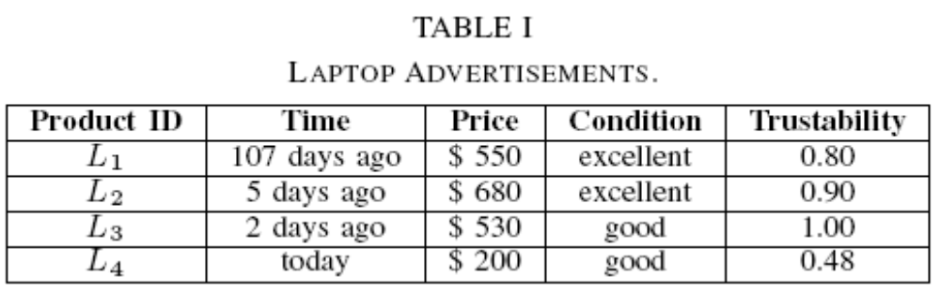
On-line Shopping System
Each products are evaluated in various aspects
In addition, the seller is associated with a “trustability”.
Customers may want to continuously monitor on-line advertisements by selecting the candidates for the best deal ---- skyline points.
Note that the data is uncertain

Slide 6
Problem Statement
In this paper, we study the problem of efficiently retrieving skyline elements from the most recent N elements for a sequence of uncertain elements in a d-dimensional numeric space, with the skyline probabilities not smaller than a given threshold q (0 < q ≤ 1)

Slide 7
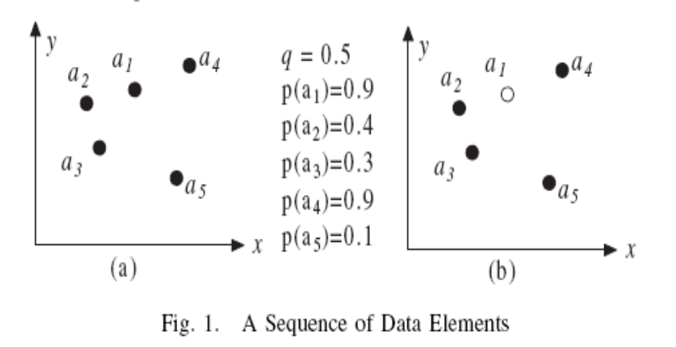
Dominating Probabilities
Psky(a) = P(a) × Pold(a) × Pnew(a)
Pnew(a4) = 1 − P(a5) = 0.9
Pold(a4) = (1−P(a2))(1−P(a3))(1−P(a1)) = 0.042
Psky(a4) = P(a4)xPnew(a4)xPold(a4) = 0.034

Slide 8
Algorithm

Slide 9
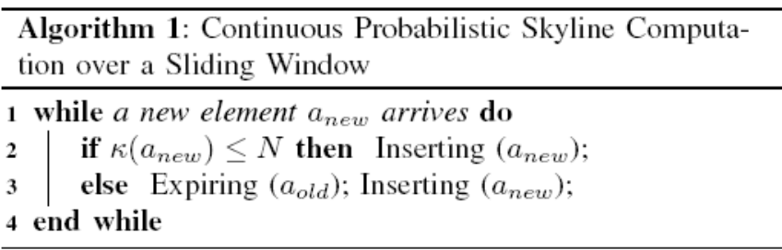
Framework
Given a probability threshold q and a sliding window with length N
aold is the oldest element in current window and inserting anew incrementally computes q-skyline.

Slide 10
Pruning
Let DSN to be the recent N elements
Using SN,q instead of the whole window of DSN
SN,q = {a|a ∈ DSN & Pnew(a) ≥ q}
  SN,q contains all skyline points with Psky ≥ q;
  Not lead to false positive nor false negative to continuously identify SN,q
  Minimality
  Size of SN,q is poly-logarithmic regarding N
SKYN,q is the solution set; that is, for each element a in SKYN,q, Psky(a) ≥ q.

Slide 11
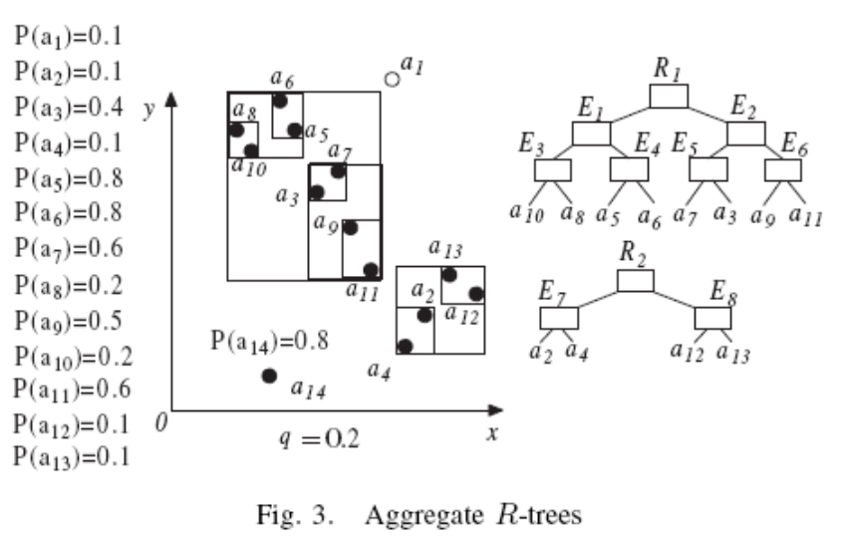
Inserting
0)In-memory R-trees R1 and R2 on SKYN,q and (SN,q − SKYN,q)
1) Update Pnew values of the elements dominated by anew by multiplying (1 − P(anew))
2) Remove the elements a with updated Pnew(a) < q from R1 and R2

Slide 12
Inserting
3) Update Psky (via Pold and Pnew) values for the elements dominated by some of those removed elements
4) Move elements a in R1 with Psky(a) < q to R2
5) Calculate Psky(anew) and insert it to R1 or R2 accordingly since Pnew(anew) = 1

Slide 13
Expiration
Once an element aold expires,
1) check if it is in SN,q. If it is in SN,q then we need to increase the Pold values for elements dominated by aold.
2) After that, we need to determine the elements that need to be moved from R2 to R1.

Slide 14
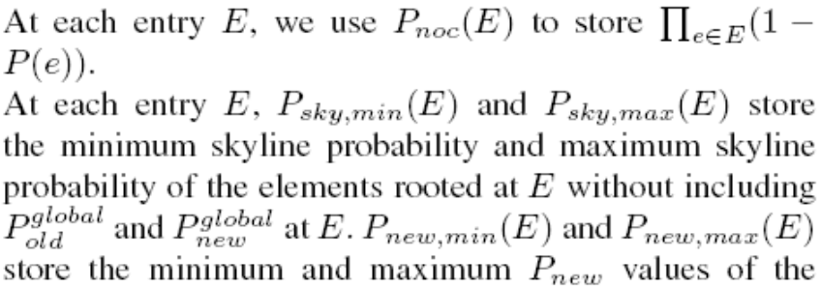
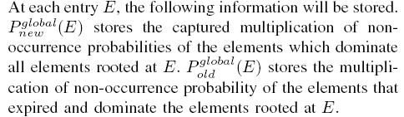
Aggregate R-Tree

Slide 15
Aggregate R-Tree
In-memory R-trees R1 and R2 on SKYN,q and (SN,q − SKYN,q)
New element a14 arrives and a1 expires
To find out the elements which are dominated by a14 and then to update R1 & R2

Slide 16
Aggregate R-Tree
If the maximum values of Pnew multiplied by (1−P(a14)) smaller than q, the entry (i.e. all elements contained) will be removed from SN,q.
On the other hand if the minimum value of Pnew multiplied by (1 − P(a14)) is not smaller than q, then the entry (i.e. all elements contained) remains in SN,q.

Slide 17
Aggregate R-Tree
Similarly, at each entry we keep the minimum and maximum values of Psky for the elements contained to possibly terminate the determination of whether elements contained are in SKYN,q.

Slide 18
Analysis
Space Complexity. Clearly, in our algorithm we use aggregate-R trees to keep each element in SN,q and each element is kept only once. Thus, the space complexity is O(|SN,q|).
Time Complexity. No sensible time complexity analysis

Slide 19
Extension
Multiple thresholds
  run multiple queries and intersect results together
Ad-hoc Queries
  “find the skyline with skyline probability at least q”.
  Assume that currently we maintain k skylines as discussed above and q ≥ qk.
  First find an Ri such that qi ≤ q < qi−1; clearly elements {Rj : j < i−1} are contained in the solution.
  Run search to get all elements in Ri with skyline probabilities ≥ q

Slide 20
Experiment

Slide 21
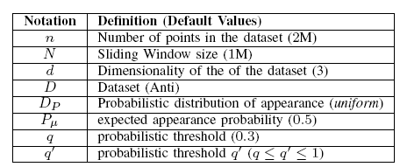
SYSTEM PARAMETERS
Intel Xeon 2.4GHz dual CPU and 4G memory under Debian Linux.
Real dataset is extracted from the stock statistics from NYSE (New York Stock Exchange).
Synthetic datasets anti-correlated

Slide 22
Algorithms
SSKY Techniques presented in Section IV to continuously compute q-skyline (i.e., skyline with the probability not less than a given q) against a sliding window.
Naïve approach on basic problem is about 20 times slower than SSKY, so it’s been ruled out

Slide 23
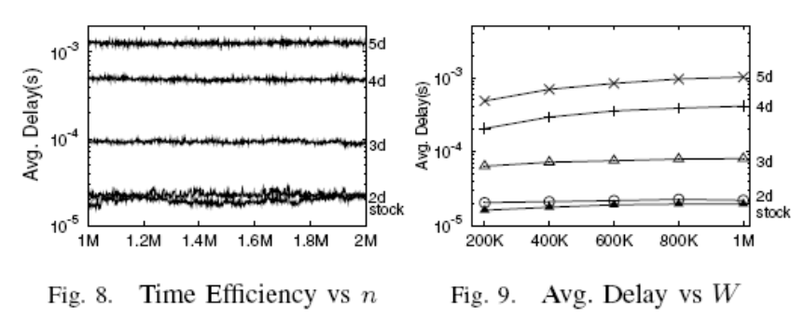
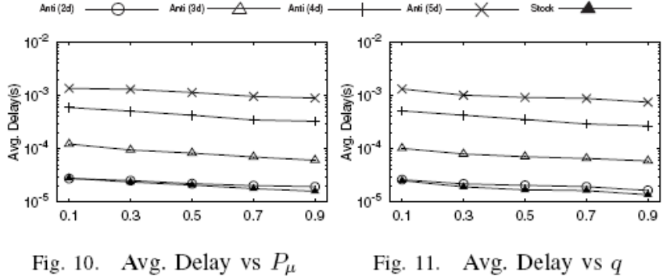
Time Efficiency
It shows that SSKY is very efficient, especially when the dimensionality is low.
For 2 dimensional dataset, SSKY can support a workload where elements arrive at the speed of more than 38K per second even for stock and anti-correlated dataset.
For 5d anti-correlated data, our algorithm can still support up to 728 elements per second, which is a medium speed for data streams.

Slide 24
Q&A
Thanks

